Slide 1

Telehealth Training
Notes:
Hi, Everyone my name is Maya Cook-Stroupe, Licensed Professional Counselor here at Garrett Counseling. I will be providing you training on The Telehealth basics.

Slide 2


Presenters
Maya Cook-Stroupe, LPC

Slide 3
Statement of conflict, competing interest, or commercial support
There are no conflict of interest or competing interest in this presentation that we are aware of.
Commercial Support: Brave Play Kit used in two activities is a product of Brave Play a division of Garrett Counseling.
Notes:
There are no conflict of interest or competing interest in this presentation that we are aware of.
Commercial Support: Brave Play Kit used in two activities is a product of Brave Play a division of Garrett Counseling.

Slide 4
You can email me at maya@garrettcounseling.com
for the handouts OR Handouts Can Be Located At:
https://drive.google.com/drive/folders/1rXlCmb0j-9KqZCV5BnkYwj5OQlYlZdfO?usp=drive_link
Notes:
IF you have any questions, You can email me at maya@garrettcounseling.com
I have the link here in which the Handouts can be located.

Slide 5
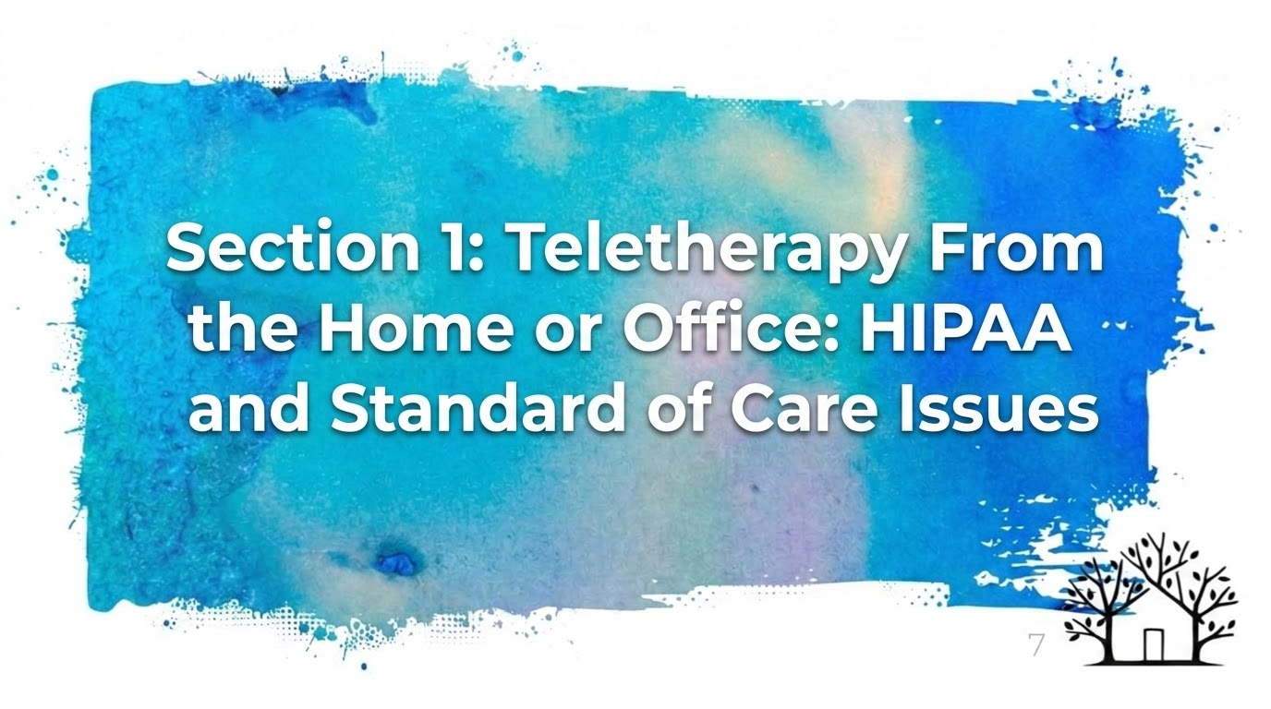
Notes:
Section 1 Teletherapy From the Home or Office: HIPAA and Standard of Care Issues

Slide 6
Let’s Get Started
Brave Play Activity:
Choose 2-3 atoms to represent what is needed at home or in the office to complete a teletherapy session effectively?
Notes:
Brave Play Activity:
Choose 2-3 atoms to represent what is needed at home or in the office to complete a telemental health session effectively?
I will give you a moment to grab your Brave Play kits. If you do not have access to your kit, I will provide a virtual kit that you can use on the next slide

Slide 7
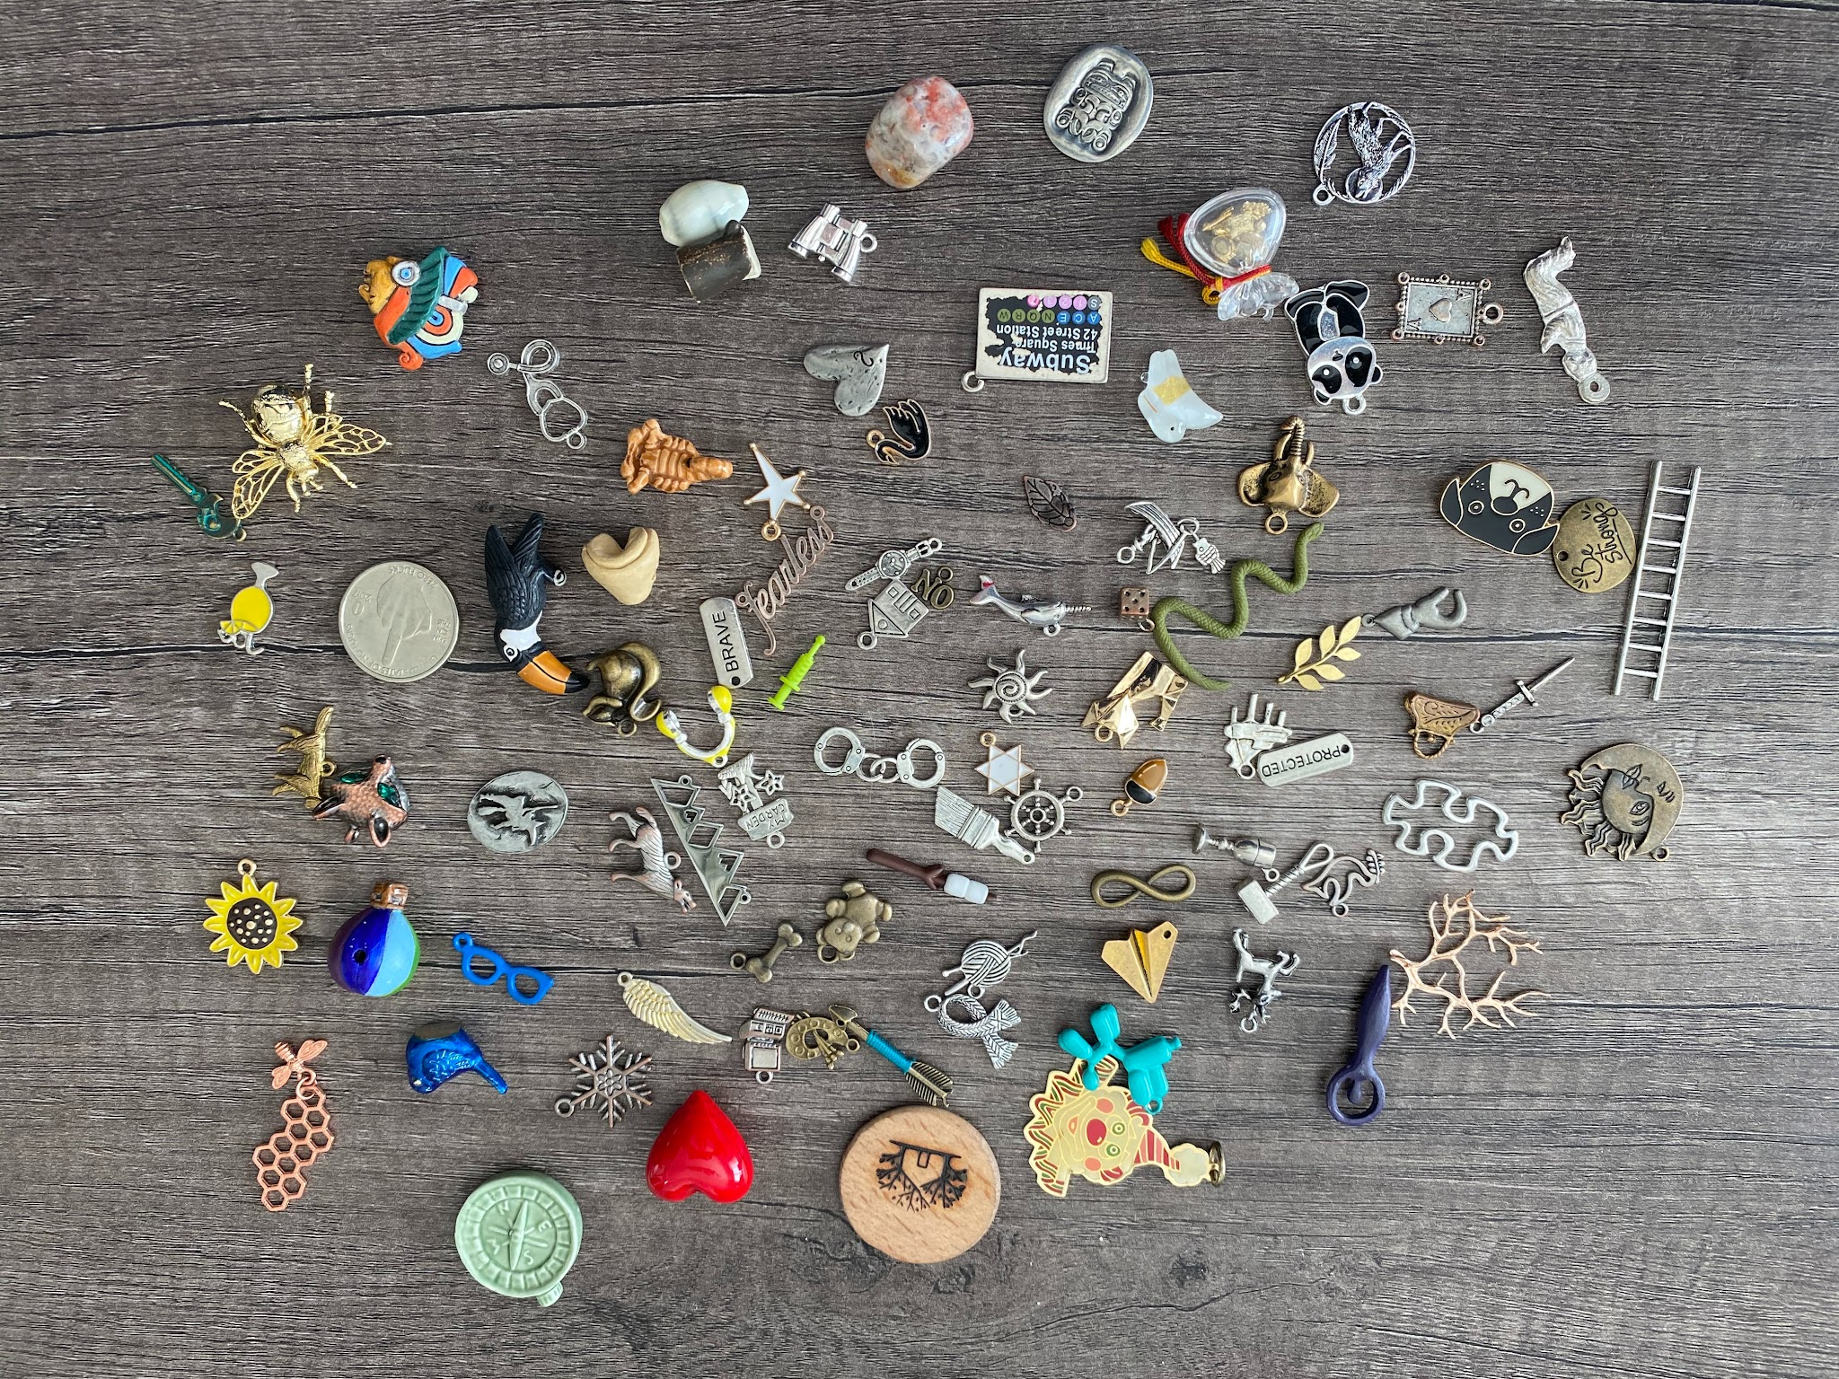

Slide 8

Home Office Issues
group
Home spaces are shared between people
verified_user
Equipment and spaces must be prepared for HIPAA standards and standards of care
Notes:
At Garrett Counseling, clinicians generally do not work from home. Remote work is typically authorized only when determined necessary by Dr. Garrett or the Practice Manager due to severe weather conditions. When working remotely, clinicians may encounter certain challenges, including:
- Shared home environments, where space may be occupied by others unless the clinician lives alone
- Ensuring that equipment and workspaces adhere to HIPAA standards and meet the required standards of care

Slide 9
Establishing a New Space
1. Choose your room
Have a full room as your workspace; portions of a room are harder to work with.
meeting_room
2. Declare the space
Find a s designated area for work and requires following your rules.
campaign
3. Run the checklist
Ensure your space complies with all relevant items on the workspace checklist.
fact_check
Notes:
When establishing a new space at home
1. Choose a room as your workspace. ○ It really is best to take a room. Portions of a room are harder to work with.
3. Run through the checklist and make sure your space complies with all the relevant items on it.

Slide 10
Workspace Checklist
Room is designated as off-limits for all others. Equipment and documents must be locked when not in use.
no_accounts
Space muffles sound well; speech at normal volume cannot be heard from outside the room.
volume_off
Face and shoulders are thoroughly lit from the front by natural or artificial light.
light_mode
Background is professional (not messy or dark). Space excludes distracting sounds like birdsong or laughter.
noise_aware
Notes:
Here is the Workspace Checklist
The room where practice work is designated as off-limits for all . The room may be opened up to others when all practice use computing equipment and documents are locked. Be sure to never leave patient information out where unauthorized persons may see it.
You are required to have a designated work space that is free of through traffic (ie a room with a door) to use when others are present in the home.
You can not be working with others in the room when you have PHI accessible. (ie your computer is out or you, note pads, client charts, phones etc)
Do not share sensitive PHI with others who should not have access, including co-workers and personal acquaintances.
Minimize the ability for others to overhear patient information, for example, saying a patient’s whole name out loud within hearing distance of others. Utilize a sound machine outside the door when others are home. You want to ensure The room where practice work is done muffles sounds well or sound blocking has been set up, such that speech at normal volume from inside the room cannot be heard from the outside of it.
Immediately dispose of information containing PHI when no longer needed by shredding paper files. (if you can not shred them then you should have them locked (double locks) until you shred them.
Therapist’s Face and Shoulders are thoroughly lit from the front either by natural or artificial lights.Background behind the therapist does not have very dark colored walls and is not a messy space.
Camera placement should always be at eye level and positioned on top of the screen, directly over the image of the person you're trying to “look at.”
When performing clinical work with audio, the space does not include distracting sounds (Such as birdsong, dog’s barking, or laughing children, Keyboard clicking)
Keyboards can be noisy and/or shake your desk. Be prepared in order to avoid this.

Slide 11
Therapist Checklist
1. Professional Attire
Clothing is professional, with no distracting patterns or on-camera strobing.
checkroom
2. Clinical Appearance
The therapist appears rested and clean during clinical work.
face
Notes:
Therapist Checklist
When performing clinical work, the therapist clothing is professional, and contains no patterns that distract the eye or strobe on camera
When performing clinical work, the therapist appears rested and clean.
Also, Therapist can Improve Eye Contact by:
Sitting further back from the screen. It can enhance the appearance of eye contact during virtual sessions.

Slide 12
Equipment Checklist
Practice devices must be locked up or encrypted when not in use.
lock
Use separate user accounts for personal and business use on shared computers.
account_circle
For clinical work, monitors should be at least 15" in size.
monitor
Perform mic checks to ensure warm sound and prevent echo.
mic
Notes:
Equipment Checklist
Practice use devices are locked up or their encryption is in its locked state when not in use
If you have one computer for personal and business use. You want to make sure Personal use of the computer is done in a user account separate from the user account for practice business.
Do not allow friends, family, etc., to use your devices that contain PHI. A work computer is for only you and only work related tasks.
Encrypt and password protect personal devices you may use to access PHI such as cell phones and tablets. Be sure to never share passwords between staff or family members.
Computer programs containing patient information (Therapy Appointment / Google) should be closed and logged out of when not in use. Lock your screens when walking away from your computer.
Only access a patient’s record if needed for work.
Avoid printing PHI; however, if necessary, keep all PHI, such as patient paperwork, charts, and records, locked away and out of view.
When performing clinical work, the monitor should be at least 15’’ in size: The Monitor size can influence the ability to observe facial expressions and affect. Additionally, it may affect each participant's capacity to navigate the space, sit at a greater distance, or perceive eye contact effectively.
Complete Mic check before session. Ensure that the mic transmits a warm sound and the mic + speaker setup prevents echos.

Slide 13
Audio Equipment Checklist
1. Use Earbuds or Headphones
Recommended to prevent echo and ensure audio clarity during sessions.
headphones
2. Headset Microphones
A headset mic can make your voice sound closer and warmer to the client.
settings_voice
3. Built-in Sound Quality
Know the quality and limitations of your computer's built-in sound options.
speaker
Notes:
Audio Equipment Checklist
Earbuds or headphones are recommended.
● Earbuds and headphones prevent echo, and a headset microphone may make your voice sound closer and warmer.
● Know the quality of your computer’s built-in sound options

Slide 14
Internet Reliability Checklist
Ensure you have a reliable and secure internet connection. Slow or “laggy” Internet can literally harm a client.
wifi
Hiding Negative Affect
Buffering or degraded images/sound can hide negative affect during a session.
visibility_off
Communication Barriers
Inability to communicate your own affect or voice at the right moment could prove detrimental.
record_voice_over
Notes:
Internet Reliability Checklist
Slow or “laggy” Internet can literally harm a client
○ Buffering or degraded images/sound can hide negative affect
○ Your inability to communicate your own affect or voice at the right moment could prove detrimental

Slide 15
Equipment & VPN Checklist
1. Mobile Office Risk
Hotel and airport connections are unsecured, making your data vulnerable.
hotel
2. Use a VPN
A VPN makes connections safe and qualifies as a "conduit" under HIPAA rules.
vpn_lock
3. Server Selection
Choose a VPN server close to your actual location for best performance.
near_me
Notes:
Securing Your Internet Connection:
Ensure your home wireless router traffic is encrypted and password protected.
Change default passwords for wireless routers.
You want to avoid preparing for a mobile office in a hotel room or Airport, the internet connection will be unsecured making your data vulnerable.

Slide 16
Connection Troubleshooting
In the Office
If issues occur in the office, contact your lead counselor. Use your cellular device to reconnect via Doxy.me to finish the session.
business
Doxy.me Failures
If Doxy.me is unavailable:
Contact scheduling for a Google Meet link.
Send Google Meet link via Client Portal (TA).
videocam_off
Notes:
Connection Troubleshooting in the office and at home
In the Office:
If you have connection issues in the office, please reach out to your lead counselor.
Use your cellular device to reconnect to the client on Doxy.me to finish the session
If you are having issues with Doxy.me.
Have scheduling reach out to client with the link to Google Meet.
Send Google Meets link to client in the Client Portal (TA)

Slide 17
Key Takeaways
Equipment & Standards
Maintain HIPAA-compliant rooms.
Wear professional, non-distracting clothing.
Use earbuds/headphones to prevent echo.
health_and_safety
Connection Failovers
Office connection issues: Reach out to your lead counselor.
Doxy.me issues: Use cellular or Google Meet.
Send Meet links via Client Portal (TA).
wifi_off
Notes:
Key TakeAways
Equipment and spaces must be prepared for HIPAA standards and standards of care
The room where practice work is designated as off-limits for all . The room may be opened up to others when all practice use computing equipment and documents are locked.
When performing clinical work, the therapist clothing is professional, and contains no patterns that distract the eye or strobe on camera
Earbuds or headphones are recommended.
Earbuds and headphones prevent echo, and a headset microphone may make your voice sound closer and warmer.
If you have connection issues in the office, please reach out to your lead counselor.
Use your cellular device to reconnect to the client on Doxy.me to finish the session

Slide 18

Section 2
Teletherapy and Remote Payment Methods
Notes:
Section 2: Teletherapy and Remote Payment Methods

Slide 19
Electronic Remote Payment
1. Client Portal (Therapy Appointment)
Pay inside the portal: Clients can securely process payments directly through the TA system.
Card Authorization Compliance:
Ensure an updated credit card authorization form is in the TA document section.
The Billing Department can only charge cards in absentia with a signed form on file.
account_balance_wallet
Notes:
Electronic Remote Payment
Here at Garrett Counseling we use a :
Practice management system known as (Therapy Appointment or TA)
○ In TA Clients will pay inside the portal
○ So it is important to ensure that your client has a updated credit card authorization form on file in the document section of TA.
Billing Department is only able to charge a card if there is authorization form on file signed by client.

Slide 20
Benefits of Card on File
Streamlined Teletherapy Sessions
No need to perform a payment process with the client at the end of the session.
videocam
Efficient No-Show Management
Makes it easy to charge for no-shows or late cancellations.
event_busy
Notes:
Benefits of Card on File
No need to perform a payment process with the client at the end of the session. That’s great for teletherapy.
○ Easy to charge for no-shows

Slide 21
Key Takeaways
Client Portal (Therapy Appointment)
Pay inside the portal: Clients can securely process payments directly through the TA system.
Card Authorization Compliance:
Ensure an updated credit card authorization form is in the TA document section.
The Billing Department can only charge cards in absentia with a signed form on file.
assignment_turned_in
Notes:
Garrett Counseling uses a Client Portal known as Therapy Appointment
Clients will:
Pay inside the portal: Clients can securely process payments directly through the TA system.
To ensure Card Authorization Compliance:
Ensure that there is an updated credit card authorization form is in the TA document section.
The Billing Department can only charge cards with a signed authorization form on file.

Slide 22
SECTION 3
HIPAA Security Compliance in Mental Health
Notes:
SECTION 3
HIPAA Security Compliance in Mental Health

Slide 23
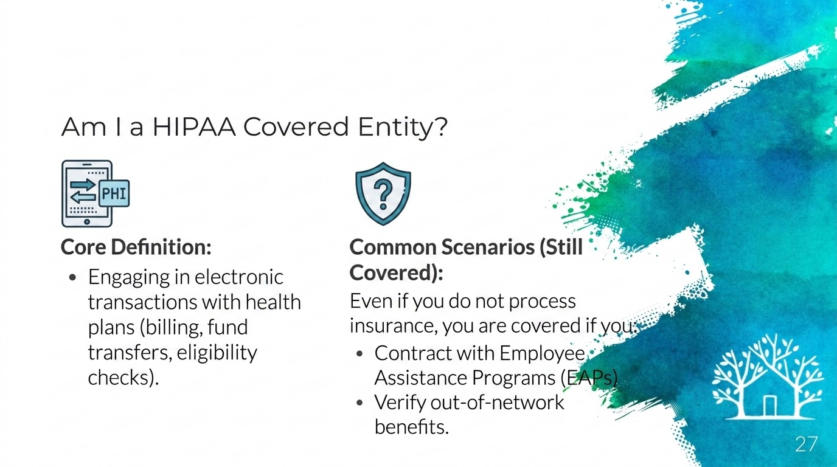
Notes:
A HIPAA-covered entity is primarily defined by engaging in electronic transactions with health plans, such as billing, fund transfers, or eligibility checks. Even if your practice doesn't process insurance claims, activities like contracting with Employee Assistance Programs (EAPs) or verifying out-of-network benefits involves electronically sharing patient information thus it can classify you as a covered entity.

Slide 24
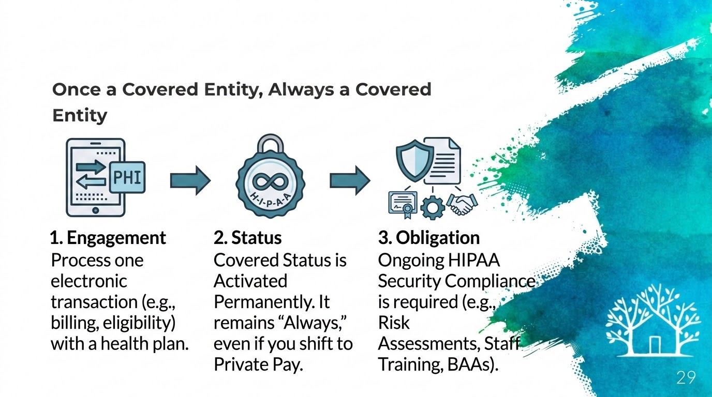
Notes:
It is important to note that once you engage in covered transactions, you remain a HIPAA-covered entity forever, even if you shift to a private pay-only practice. This permanence requires ongoing HIPAA compliance, regardless of your practice model.

Slide 25
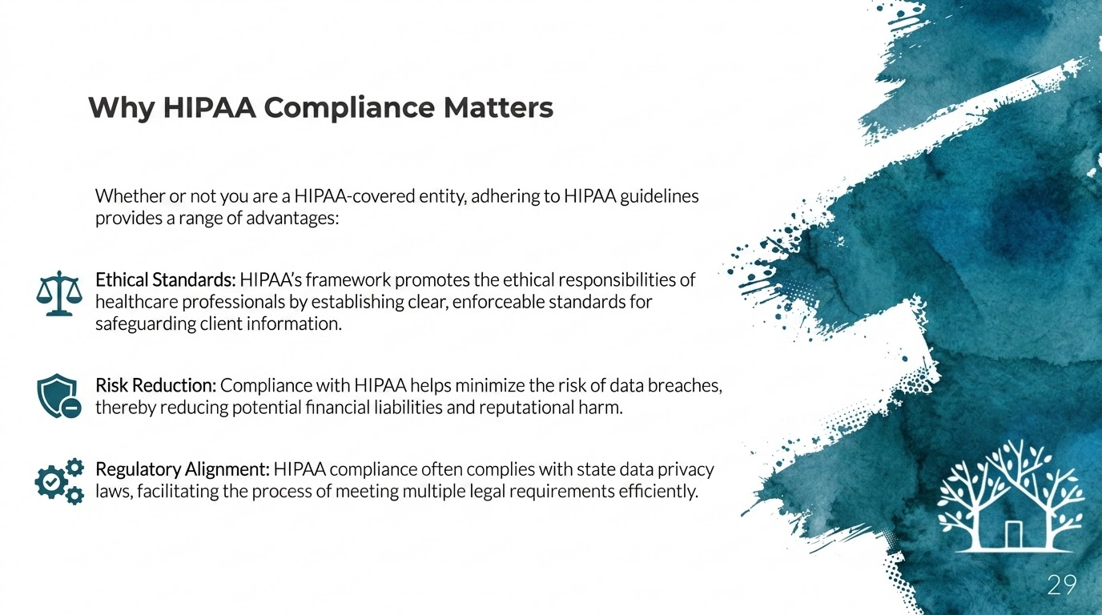
Notes:
Whether or not you are a HIPAA-covered entity, adhering to HIPAA guidelines provides a range of advantages:
Ethical Standards: HIPAA’s framework promotes the ethical responsibilities of healthcare professionals by establishing clear, enforceable standards for safeguarding client information.
Risk Reduction: Compliance with HIPAA helps minimize the risk of data breaches, thereby reducing potential financial liabilities and reputational harm.
Regulatory Alignment: HIPAA compliance often complies with state data privacy laws, facilitating the process of meeting multiple legal requirements efficiently.

Slide 26
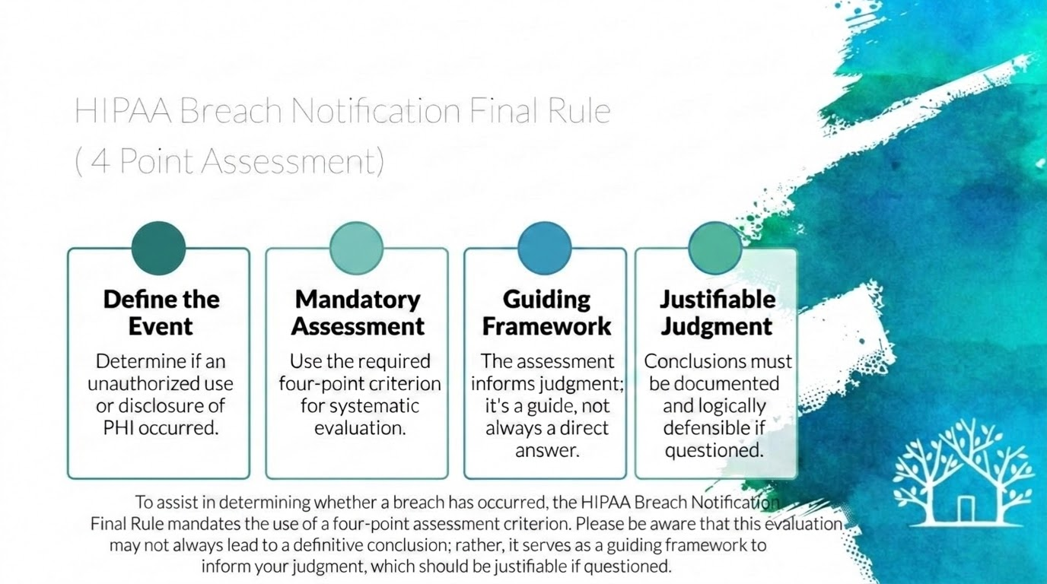
Notes:
To assist in determining whether a breach has occurred, the HIPAA Breach Notification Final Rule mandates the use of a four-point assessment criterion. Please be aware that this evaluation may not always lead to a definitive conclusion; rather, it serves as a guiding framework to inform your judgment, which should be justifiable if questioned.
The HIPAA Breach Notification Rule allows you to:
Define the Event: Determine if an unauthorized use or disclosure of PHI occurred.
Provides a Mandatory Assessment: Use the required four point criterion for systematic evaluation.
Is a Guided Framework: In which the assessment informs judgement; Again its a guide, not always a direct answer
Provides a Justifiable Judgement: Conclusions must be documented and logically defensible if questioned.

Slide 27
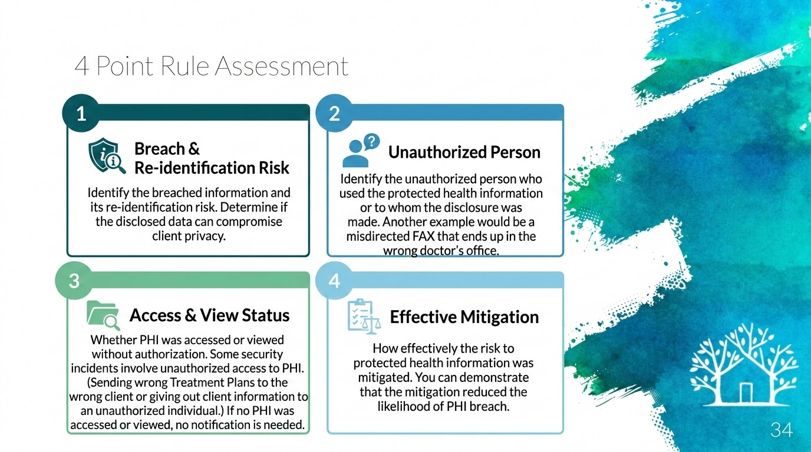
Notes:
Identify the breached information and its re-identification risk. Determine if the disclosed data can compromise client privacy.
Identify the unauthorized person who used the protected health information or to whom the disclosure was made. Another example would be a misdirected FAX that ends up in the wrong doctor’s office.
Whether PHI was accessed or viewed without authorization. Some security incidents involve unauthorized access to PHI. (Sending wrong Treatment Plans to the wrong client or giving out client information to an unauthorized individual.) If no PHI was accessed or viewed, no notification is needed.
How effectively the risk to protected health information was mitigated. You can demonstrate that the mitigation reduced the likelihood of PHI breach.

Slide 28
If You Experience a HIPAA Breach
In the event of a HIPAA breach, please ensure that the practice manager is promptly informed.
Notes:
In the event of a HIPAA breach, please ensure that the practice manager is promptly informed.

Slide 29
Section 4: Telemental Health I: An Orientation
Notes:
Section 4: Telemental Health I: An Orientation

Slide 30
Brave Play Activity
Choose 2-3 atoms to represent what is in and out of your control when engaging in Telemental Health services
Notes:
Let’s get started
We will start this section with a short brave play activity. I’ll give you a moment to grab you brave play kits. If you don’t have access to your brave play kits I will have a virtual brave play kit for you to use.
Choose 2-3 atoms to represent what is in and out of your control when engaging in Telemental Health services

Slide 32
In your space, you control
lockPrivacy
volume_upSoundscape
groupAccess by others
phone_in_talkEmergency numbers
weekendFurniture setup
mapDistance to services
lightbulbLighting
gavelYour legal duties
Notes:
For TeleMental Health, here are some factors that are within your control
Privacy
● Access to the space by others
● Placement and Orientation of furniture
● Lighting
● Soundscape
Emergency numbers
● Distance to services
● Your legal duties

Slide 33
In telemental health, you don’t control the client’s space.
Clinicians do not have control over:
lock Privacy
security Client’s safety
group Access by others
place Location of the client
home Therapy-affirming space
Notes:
In telemental health, you don’t control the client’s space.
Clinicians do not have control over:
Privacy
Client’s space is accessed by others
Whether client’s space is a Therapy-affirming space
Client’s safety
Location of the client
Clinicians do not have control over:
Privacy
Client’s space is accessed by others
Whether client’s space is a Therapy-affirming space
Client’s safety
Location of the client

Slide 34
Informed Consent
Informed Consent for Telehealth Services
assignment_late
Additional TMH Requirements
TMH calls for informed consent items in addition to your standard informed consent.
description
Intake Paperwork
Informed Consent: for Telehealth services and Tech Safety Consent Form in TA.
Notes:
Informed Consent: (Informed Consent for Telehealth Services )
TMH calls for informed consent items in addition to your standard informed consent.
Intake Paperwork :
Informed Consent: for informed consent Telehealth services and Tech Safety Consent Form in TA.

Slide 35
Informed Consent: (Informed Consent for Telehealth Services )
TMH calls for informed consent items in addition to your standard informed consent.
Important to note that there is a chance technology can fail on us, potentially in sensitive situations.
As a Result, a plan for resuming contact with the therapist after a technology failure. (Tech Safety Plan)
There should be an ongoing expectation that the therapist will be assessing the appropriateness of telemental health for your clients.
Therapist should provide advice on how the client may compromise their own confidentiality through their own behaviors around personal security, or through sharing information about their telemental health sessions with others.
Notes:
Informed Consent: (Informed Consent for Telehealth Services )
TMH calls for informed consent items in addition to your standard informed consent.
Important to note that there is a chance technology can fail on us, potentially in sensitive situations.
As a Result, a plan for resuming contact with the therapist after a technology failure. (Tech Safety Plan)
There should be an ongoing expectation that you as the therapist will be assessing for the appropriateness of telemental health for your clients.
Therapist should provide advice on how the client may compromise their own confidentiality through their own behaviors around personal security, or through sharing information about their telemental health sessions with others.
Now I will walk you through how to find the informed consent and the tech safety consent form

Slide 36
Section 5:
Practicing Via Telemental Health II: Care Delivery Fundamentals and The Clinician-Client Relationship
Notes:
Section 5:
Practicing Via Telemental Health II: Care Delivery Fundamentals and The Clinician-Client Relationship

Slide 37
Practicing in Your Licensed State
JURISDICTION & LICENSURE
• Authorized Practice: Clinicians are authorized to conduct sessions only within the state in which they hold active licensure.
• Session Location: Licensing jurisdiction is determined strictly by the client's physical location at the exact time of the session, not by their state of residence.
OUT-OF-STATE PROTOCOL
• Session Disruption: If a client is outside the clinician's licensed state during a session, the appointment cannot proceed.
• Action Required: Advise the client to immediately contact the scheduling department to reschedule for a time when they return to the licensed jurisdiction.
Notes:
Clinicians are authorized to conduct sessions only within the state in which they hold licensure.
Licensing jurisdiction is determined based on the client's location at the time of the session, not their residence.
If a client is located outside of the clinician’s licensed state at the time of the session, the clinician will be unable to proceed with the telehealth appointment. In such cases, please advise the client to contact the scheduling department to reschedule the appointment for a time when the client is within the licensed jurisdiction.
For example, if a client travels to Florida and wishes to have a telehealth session during their trip, the session cannot be conducted unless the client is in a state where the clinician is licensed. The client should reach out to scheduling to arrange a new appointment when they are in the appropriate jurisdiction.

Slide 38
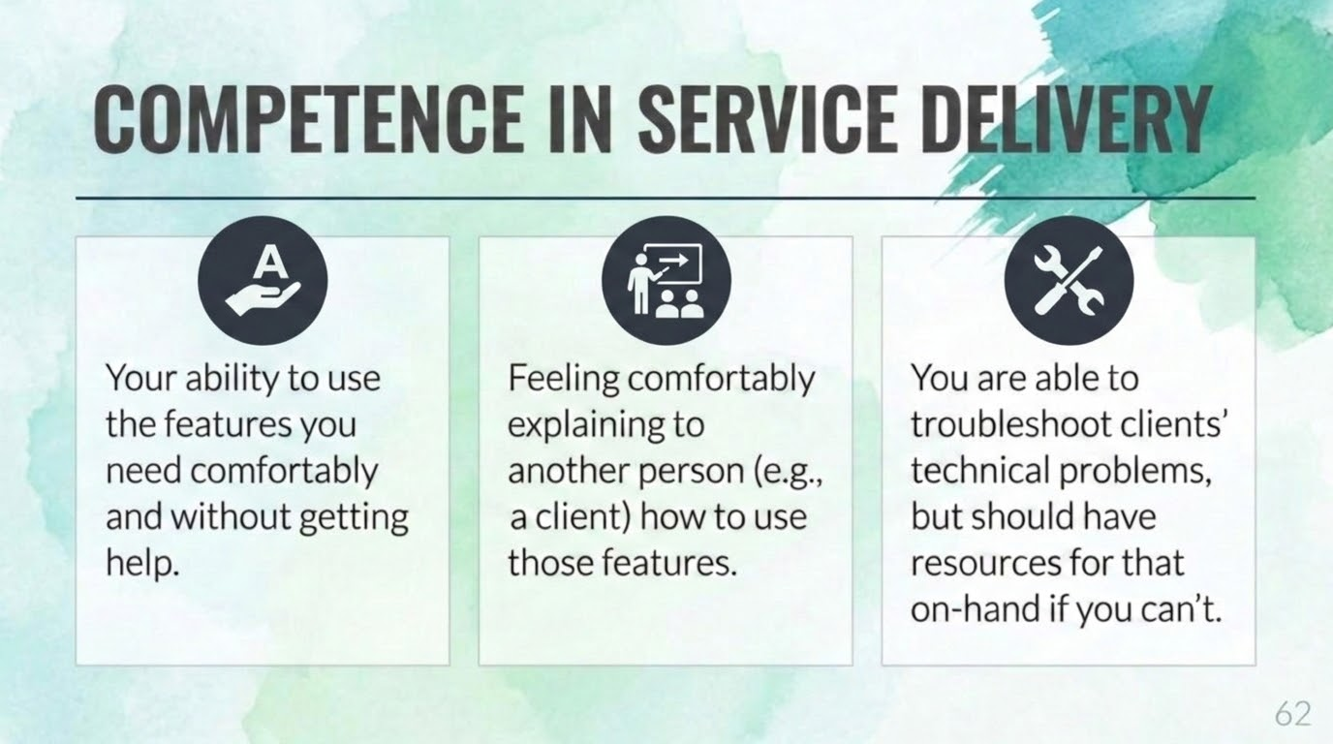
Notes:
Competence in Service Delivery
Competence in service delivery is often defined as:
○ Your ability to use the features you need comfortably and without getting help.
○Feeling comfortably explaining to another person (e.g. a client) how to use those features.
○ You are able to troubleshoot clients’ technical problems, but should have resources for that on-hand if you can’t

Slide 39
Doxy.me
Competency
PREPARATION
laptop_macYou’re using the largest screen available to you
menu_bookYour device is propped up to have the camera level with your eyes (use books if necessary)
wb_sunnyMake sure you’re in a well-lit space without a bright light behind you
CONNECTIVITY
routerYour computer is close to your WiFi router (or plugged in with a cable)
blockCLEAR YOUR INTERNET: Don’t have any other pages, sites, or programs running during your session.
PRESENTING & DOCUMENTS
accessibilityUpright posture with face prominent in the center
meeting_roomNo distractions and no other people in the room
checkroomCalm, solid-colored clothing
descriptionHave the following forms ready:
Tech Recovery and Safety Plan
Notes:
Doxy.Me Competency
Before the session...
You’re using the largest screen available to you
Your device is propped up in order to have the camera about level with your eyes (use books if necessary)
Please make sure that you’re in a well-lit space and don’t have a bright light source directly behind you
Your computer is close to your WiFi router (or plugged into the router with a cable if necessary)
CLEAR YOUR INTERNET: Don’t have any other pages, sites, or programs running during your session. Close any programs you don’t need which use your Internet connection.
Upright posture with face prominent in the center of the screen
No distractions in the environment and no other people in the room
Calm, solid-colored clothing - nothing low cut cause it looks like you have no clothes on
Complete a Audio & Video Check: Take proactive steps to ensure there are no audio or visual issues before the session begins. Test your microphone, camera, and connection stability.
Mobile devices experience fluctuations. The general consensus is that they should not be used when close assessment of expression and affect is required.
Have the following forms with you, ready to review:
Tech Recovery and Safety Plan (client completes at intake)

Slide 40

Doxy.me
Competency
Initial Program
Doxy.me
✓You can invite clients from Doxy if needed, though the office typically sends the information automatically.
▸Press "Copy Link" button
▸Send to client through their Therapy Appointment Portal
✓Clients will appear in the top-left corner under CLIENT (PATIENT) QUEUE. Click on their name to begin.
Backup Program
Google Meets
✓Use as the secondary fallback protocol if the primary Doxy.me connection fails or experiences severe lag.
✓Ensure you have a meeting link generated and ready to send via email or portal message if switching platforms.
Notes:
Doxy.Me Competency
Initial Program - Doxy.me…
Back up Program - Google Meets
You can invite them from Doxy if needed, but the office also sends them the information.
Press “Copy Link“ button
Send to the client through their Therapy Appointment Portal
You will then see the client in the top left corner under CLIENT (PATIENT) QUEUE, then click on the client name.

Slide 41
Doxy.me
Competency
SESSION START CHECKLIST
check_circleVerify the client’s space is safe and confidentiality is secure
check_circleEnsure there are no hidden people
check_circleHelp client make adjustments as needed
check_circleVerify identity if necessary (i.e., if conducting phone session)
check_circleReview Teletherapy Informed Consent and get verbal assent
check_circleReview Tech Recovery and Safety Plan together
play_circle_filledProceed with the session!
Notes:
At the beginning of the session…
Verify the client’s space is safe and confidentiality is secure
Ensure there are no hidden people
Help client make adjustments as needed
Verify identity if necessary (i.e., if conducting phone session)
Review Teletherapy Informed Consent and get verbal assent for teletherapy
Review the Tech Recovery and Safety Plan form together(client completes at intake)
Proceed with the session!

Slide 42
Doxy.me
Competency
ONGOING CARE & TERMINATION
check_circleKeep confirming location and checking safety
check_circleContinue assessing appropriateness of telemental health
check_circleCheck in with the client about the platform on occasion
check_circleAt termination, supply some in-person referrals if called for and where feasible
Notes:
Doxy.me
Competency Ongoing Care and Termination
Keep confirming location and checking safety
Continue assessing appropriateness for telehealth services
Check in with the client about their appropriateness on occasion
At termination, be sure to supply some in-person referrals if it is called for and where feasible

Slide 43
Section 6: Practicing Via Telemental Health III: Preparing to Practice
Notes:
Section 6: Practicing Via Telemental Health III: Preparing to Practice

Slide 44
Functional Equivalence: TMH Via Video and Traditional Setting
Videoconferencing (or, sometimes, telephone) is the go-to medium for TMH due to its functional equivalence to traditional settings.
They are perceived as functional equivalents due to their similarity of traits
Clinicians are typically drawn to videoconferencing as their TMH medium of choice because It is synchronous and has audio and video, which makes it easiest to use one’s existing clinical skills through it
Notes:
Functional Equivalence: TMH Via Video and Traditional Setting
Videoconferencing (or, sometimes, telephone) is the go-to medium for TMH due to its functional equivalence to traditional settings.
They are perceived as functional equivalents due to their similarity of traits
Clinicians are typically drawn to videoconferencing as their TMH medium of choice because It is synchronous and has audio and video, which makes it easiest to use one’s existing clinical skills through it

Slide 45
Reimbursement of Telemental Health
Garrett Counseling accept reimbursements from:
EAPs
Medicaid
Private insurance (BCBS and Aetna)
PPAY
Max Program
Notes:
Reimbursement of Telemental Health
Garrett Counseling accept Reimbursements from:
EAPs
Medicaid
Private insurance (BCBS and Aetna)
PPAY
Max Program

Slide 46
Reimbursement of Telemental Health
CPT Codes and Modifiers to use for Telehealth Services
CPT Codes: • 90832 – Psychotherapy 30 minutes. Time minimum: 16-37 minutes
• 90834 – Psychotherapy 45 minutes. Time minimum: 38-52 minutes
• 90837 – Psychotherapy 60 minutes. Time minimum: 53-60 minutes (60 min Medicaid)
Modifiers: For BCBS (and most major insurances) telehealth
‘95’ is the telehealth modifier for BCBS. So for ALL telehealth BCBS sessions you should have both ‘59’ AND ‘95’
Place of Service Code- 02 (Telehealth provided other than in Patient’s Home) or 10 (Telehealth provided in Patient’s Home)
Modifiers: For Medicaid telehealth
Telehealth modifier for Medicaid is ‘GT’ - ALL Medicaid Telehealth
sessions require ‘GT’ modifier. So for ALL Medicaid telehealth sessions you should have ‘59’ AND ‘GT’
90785 add-on code is NOT eligible for reimbursement when doing telehealth for Medicaid
Use 11 for Place of Service code
Notes:
Reimbursement of Telemental Health
CPT Codes and Modifiers to use for Telehealth Services
CPT Codes: • 90832 – Psychotherapy 30 minutes. Time minimum: 16-37 minutes
• 90834 – Psychotherapy 45 minutes. Time minimum: 38-52 minutes
• 90837 – Psychotherapy 60 minutes. Time minimum: 53-60 minutes (60 min Medicaid)
Modifiers: For BCBS (and most major insurances) telehealth
‘95’ is the telehealth modifier for BCBS. So for ALL telehealth BCBS sessions you should have both ‘59’ AND ‘95’
Place of Service Code- 02 or 10 (Telehealth provided in Patient’s Home)
Modifiers: For Medicaid telehealth
Telehealth modifier for Medicaid is ‘GT’ - ALL Medicaid Telehealth
sessions require ‘GT’ modifier. So for ALL Medicaid telehealth sessions you should have ‘59’ AND ‘GT’
90785 add-on code is NOT eligible for reimbursement when doing telehealth for Medicaid
Use 11 for Place of Service code
POS for telehealth sessions for medicaid is 11 - Office (regardless of where the client is at during the session, but not in office). Should be POS 11 and Modifiers 59/GT (GT lets them know that it was a telehealth session)

Slide 47
Reimbursement of Telemental Health
CPT Codes and Modifiers to use for Telehealth Services Special Circumstances :
CPT Codes:
For all PPAY clients, the ‘Private Pay’ CPT code should be used. Please be sure to apply this CPT code so that charges are collected correctly.
For all EAP clients the ‘EAP’ CPT should be used for all EAP clients. (unless you are specifically told differently by billing.)
For all MAX Clients the ‘MAX’ CPT should be used for all MAX clients.
No modifiers needed for PPAY, EAP or MAX.
All No Shows with the exception of Medicaid should be documented using the NSHOW CPT.
Medicaid no shows should be coded as NSMED
Waived No Shows should be coded WAIVNS. You will know that you are to waive the no show because you will get an email from the scheduler telling you to waive the fee. The ONLY time you will use this code will be when you have email telling you it has been approved.
Notes:
CPT Codes and Modifiers to use for Telehealth Services Special Circumstances :
CPT Codes: For all PPAY clients, the ‘Private Pay’ CPT code should be used. Please be sure to apply this CPT code so that charges are collected correctly.
For all EAP clients the ‘EAP’ CPT should be used for all EAP clients. (unless you are specifically told differently by billing.)
No modifiers needed for PPAY, EAP or MAX.
All No Shows with the exception of Medicaid should be documented using the NSHOW CPT.
Medicaid no shows should be coded as NSMED
Waived No Shows should be coded WAIVNS. You will know that you are to waive the no show because you will get an email from the scheduler telling you to waive the fee. The ONLY time you will use this code will be when you have email telling you it has been approved.

Slide 48
Section 7:
Practicing Via Telemental Health IV: Engaging in HIPAA Security and Digital Confidentiality as a Mental Health Professional

Slide 49
Brave Play Activity
Choose 2-3 atoms to represent the differences in the duties of HIPAA laws and Ethical Codes.

Slide 51
What You Know About Security
According to the Huggins Model:
Security is the logistics of how we go about maintaining our ethical duty of confidentiality.
Privacy:Client choices about information, meaning what clients do to keep their info away from others
Confidentiality: is our ethical duty as mental health professionals to uphold clients' privacy choices.
Notes:
According to the Huggins Model:
Security is the logistics of how we go about maintaining our ethical duty of confidentiality.
Privacy:Client choices about information, meaning what clients do to keep their info away from others
Confidentiality: is our ethical duty as mental health professionals to uphold clients' privacy choices.

Slide 52
Security and Privacy in Ethics Codes vs. HIPAA
Ethics codes remind us of our ethical duty as mental health professionals to protect client confidentiality, but they don't specifically tell us how to do that, whether in the digital or non-digital realms. Legal duties are covered by HIPAA laws, which include many standards and are a lot more specific about cybersecurity, providing detailed guidance.
The practitioner must attend to the sacred duty of client confidentiality by considering both the ethical and legal context. This requires focusing not just on your legal duties per HIPAA, but also on your ethical duties for upholding standards of care as a mental health professional.
Notes:
Security and Privacy in Ethics Codes vs. HIPAA
Ethics codes remind us of our ethical duty as mental health professionals to protect client confidentiality, but they don't specifically tell us how to do that, whether in the digital or non-digital realms. Legal duties are covered by HIPAA laws, which include many standards and are a lot more specific about cybersecurity, providing detailed guidance.
The prudent practitioner must attend to the sacred duty of client confidentiality by considering both the ethical and legal context. This requires focusing not just on your legal duties per HIPAA, but also on your ethical duties for upholding standards of care as a mental health professional.

Slide 53
Communication Policy to Maintain HIPAA and Ethical compliance
As a clinician you want to make sure client information is confidential and secure.
In order to ensure HIPAA and Ethical Compliance communication with clinicians and clients should be conducted in the messaging tab in TA (The Client Portal) or through your scheduler.
Notes:
As a clinician you want to make sure client information is confidential and secure.
In order to ensure HIPAA and Ethical Compliance communication with clinicians and clients should be conducted in the messaging tab in TA (The Client Portal) or through your scheduler.
You want to communicate to your clients that the best way for you to be reached will be for the client to send you messages through Therapy Appointment. IF there is Any questions or concerns about billing, scheduling, or anything nonclinical needs to be directed to the appropriate department.
Important to note that *** You can NOT share the documents via Google Drive because it then shows who has access to the file (ie - clients who then are not HIPAA protected). You must download and save to your desktop documents to send to clients via Telehealth.
You can send documents through the “PDF Forms”. You can store clinically important documents in the “Docs on File” section of the client’s Therapy Appointment Portal.
Be sure to Limit email transmissions of PHI to only those circumstances when the information cannot be sent another way. At a minimum, use encryption tools (most businesses provide tools to send encrypted emails). Your Google Workspace email is HIPAA- Compliant with BAA. Therapy Appointment portal is HIPAA-Compliant with BAA

Slide 54
Potential Risks when using Personal Devices
Threats (or hazards) are actors or circumstances that cause risks to exist. Taking the time to think about relevant threats gives you a better picture of the risks you need to prepare for
threats can impact your computer, smartphone, external drive, etc. include theft, loss, viruses/malware, password guessing, breakage, natural disasters, and giant magnets
What's relevant is not the devices themselves, but the protected health information they handle. It's important to examine how threats impact the confidentiality, integrity, and availability of the information.
Notes:
Threats (or hazards) are actors or circumstances that cause risks to exist. Taking the time to think about relevant threats gives you a better picture of the risks you need to prepare for.
Example threats that can impact your computer, smartphone, external drive, etc. include theft, loss, viruses/malware, password guessing, breakage, natural disasters, and giant magnets
What's relevant is not the devices themselves, but the protected health information they handle. It's important to examine how threats impact the confidentiality, integrity, and availability of the information.

Slide 55
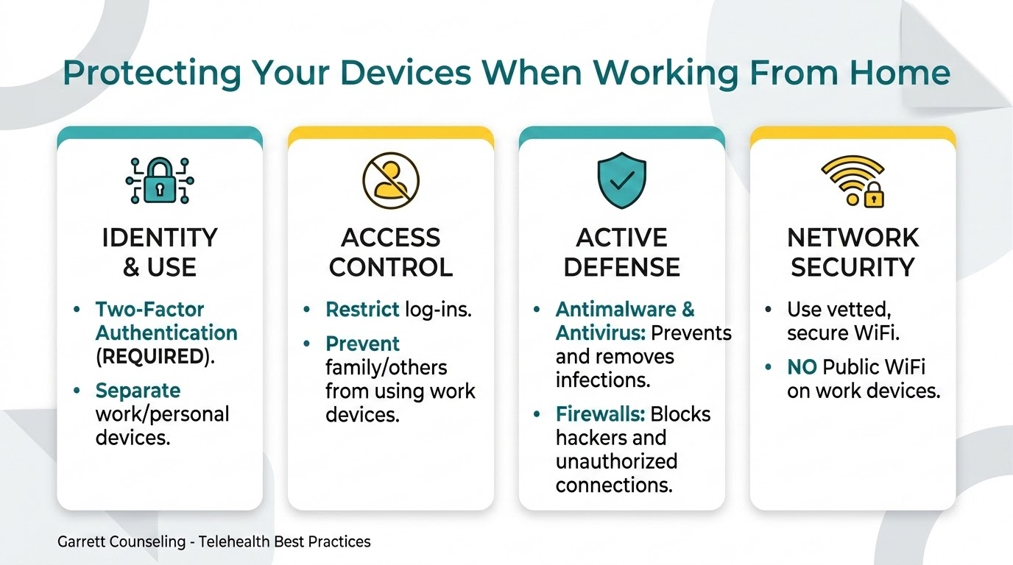
Notes:
Protecting Your Devices when working from home
Two factor Identification is Required. Ex: Would be your password for TA and email of a security code to access TA.
Have a separate device for work related task
Keep family members from logging into your devices will increase the chance of risk and threats to your data.
antimalware and antivirus software protect your device
Antimalware prevents malicious software from infecting your device, and antivirus software removes viruses that have already infected your device
-Fire walls: They block hackers from entering your device’s Internet doorway and prevent viruses from connecting to the Internet to send information back to hackers
antimalware, antivirus software, and firewalls help you meet HIPAA standards help maintain the security of protected health information by keeping intruders out
using vetted secure WiFi help you meet HIPAA standards protects the confidentiality and integrity of protected health information both on your device and that you send over the Internet using the WiFi service
No public wifis on work devices.

Slide 56
Takeaways: The ethical and legal context of security in mental health practice
HIPAA laws set the standards of care around digital security and provide detailed guidance for mental health professionals
Ethics codes state the duty of mental health professionals to protect client confidentiality and attend to digital security
Notes:
Takeaways: The ethical and legal context of security in mental health practice
HIPAA laws set the standards of care around digital security and provide detailed guidance for mental health professionals
Ethics codes state the duty of mental health professionals to protect client confidentiality and attend to digital security

Slide 57
LINKS
Resources/Handouts:
insert
References:
https://personcenteredtech.com
Brave Play Kit :
https://garrettcounseling.com/brave-play-kit/

