Slide 1

Parent/Caregiver Involvement for Moderate-to-High-Risk Adolescents
Notes:
In this video we will discuss Parent/Caregiver Involvement for Moderate-to-High-Risk Adolescents.

Slide 2


Let’s Get Started
Brave Play Activity:
Choose 2-3 atoms that represent what it feels like in your body when you are conducting a safety assessment and a parent is also present in the session.
Focus on somatic experience:
Weight, temperature, and pressure
Movement vs. stillness
Notes:
If you have your Brave Play Kit, please get it out. If you do not I will display one for you. Choose 2-3 atoms that represent what it feels like in your body when you are conducting a safety assessment and a parent is also present in the session.
Focus on somatic experience:
Weight, temperature, and pressure
Movement vs. stillness

Slide 3
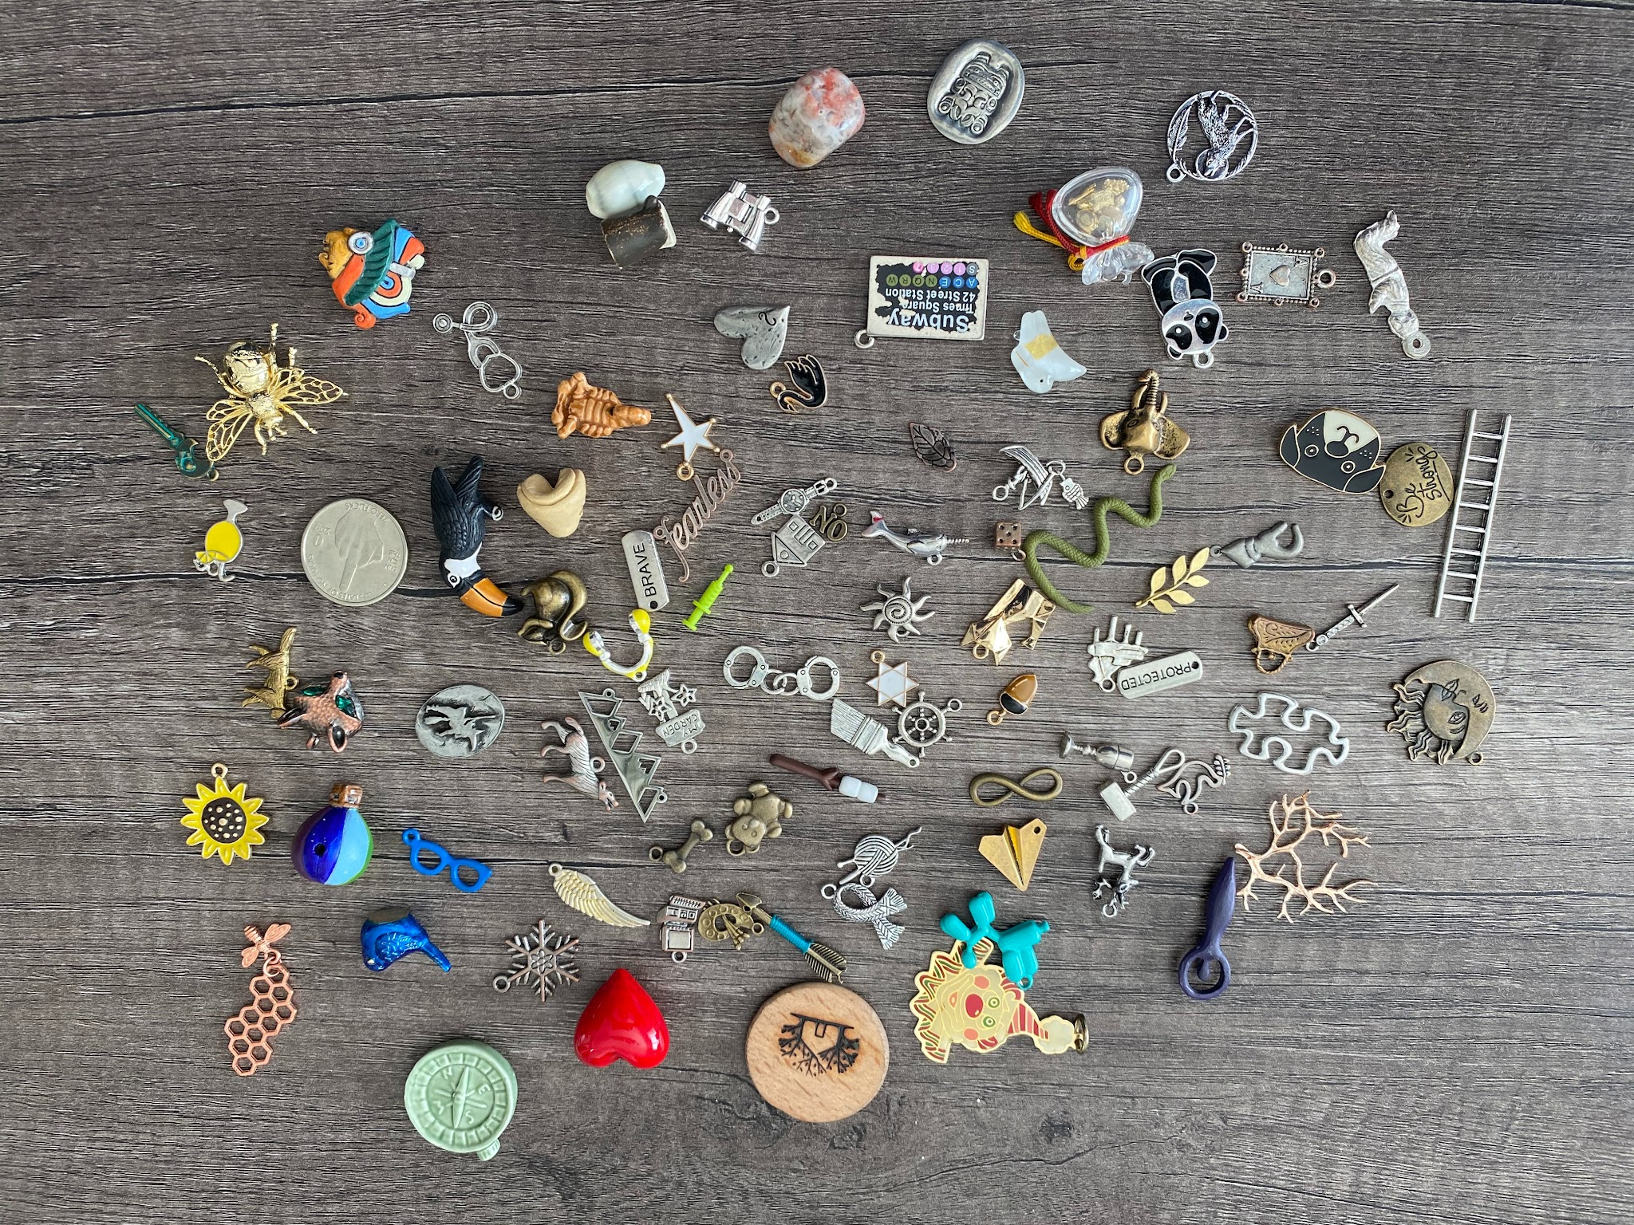
Notes:
****Stay on this slide for 2 minutes. After the 2 minutes**** Lead counselors please lead a discussion having a few attendees share. I will pause for 4 minutes. ****After 4 minutes***** Okay let’s all come back together. I am sure that anxiety, uncertain, maybe even panic were discussed.

Slide 4
Guided Reflection
Take a moment to write down the atoms you selected and share what drew you to each one.
Notes:
Take a moment to write down the atoms you selected and share what drew you to each one. Please be sure to turn your reflection in to your lead counselor at the end of the video.

Slide 5
Parent/Caregiver Meeting Requirements
Mandatory Frequency
For minor clients at moderate to high risk for suicidal ideation or self-harm:
At least one meeting per month
In addition to weekly individual appointments
Focus: Treatment planning, support, and risk management
Meeting Format & Flexibility
Meetings can include the adolescent or be conducted separately with the caregiver.
Considerations for Clinical Judgment:
Treatment goals & safety
Developmental needs
Relational dynamics
Notes:
For minor clients identified as moderate and high risk for suicidal ideation, self-harm, or other high-risk behaviors, clinicians are required to conduct at least one parent/caregiver meeting per month (in addition to the ongoing weekly appointments with individual client) as part of ongoing treatment planning, relational support, and risk management.
Meetings may occur with the adolescent present or separately with the parent/caregiver. The format of the meeting should be based on clinical judgment, treatment goals, developmental needs, relational dynamics, and safety considerations.

Slide 6
Purpose of Parent/Caregiver Meetings
Foundational Goals
Strengthen caregiver engagement before active crisis
Promote a proactive, relational, and supportive environment
Relational Impact
Increase positive attachment and communication
Reduce pattern of only involving caregivers during crises
Clinical & Educational Focus
Improve understanding of risk factors and safety planning
Review coping tools and session resources
Improve treatment consistency and clinical buy-in
Notes:
These meetings are intended to strengthen caregiver engagement and collaboration before a client reaches active crisis; Increase positive attachment, communication, and connection between caregivers and adolescents; Improve caregiver understanding of risk factors, warning signs, emotional regulation, and safety planning; Review safety plans, coping tools, and resources discussed in session; Improve treatment consistency, follow-through, and clinical buy-in; Reduce the pattern of involving caregivers only during crises or escalations; and Promote a proactive, relational, and supportive treatment environment.

Slide 7
Clinical Rationale
Research supports consistent caregiver involvement in the treatment of moderate-to-high-risk minors.
Limiting parent involvement to periods of crisis may unintentionally reinforce negative interaction patterns where caregiver involvement becomes associated with conflict, punishment, or emotional escalation.
Regular meetings outside of crisis help improve:
Attachment & communication
Collaborative problem solving
Treatment adherence & continuity of care
Notes:
Research supports consistent caregiver involvement in the treatment of moderate-to-high-risk minors. Limiting parent involvement to periods of crisis may unintentionally reinforce negative interaction patterns in which caregiver involvement becomes associated primarily with conflict, punishment, or emotional escalation. Regular caregiver meetings outside of crisis situations help improve attachment, communication, collaborative problem solving, treatment adherence, and continuity of care.

Slide 8
Office Scheduling Expectations
Protocol for Moderate-to-High Risk Adolescents
When a clinician identifies an adolescent client as moderate-to-high risk, the following action is mandatory:
Notify Scheduling: Inform Scheduling that recurring parent/family sessions are clinically indicated. Meetings may include the family with or without the client present.
Notes:
When a clinician identifies an adolescent client as moderate-to-high risk, the clinician must notify the scheduling team that recurring parent/family sessions are clinically indicated. Sessions may include either family with or family without client present.

Slide 9
Clinician Responsibility & Scheduling
The clinician is responsible for adding the client to the “Parent Session Tracker.”
Schedulers support ongoing scheduling of recurring sessions. If preferred formats aren't available, alternates or temporary note time may be used.
Documentation Requirements for Declines/Resistance:
Schedulers must document: Scheduling attempts, refusals, resistance, or barriers.
Clinicians must document:
Recommendation made in session and through outreach
Parent/caregiver refusal or inability to participate
Efforts made to re-engage the caregiver
Clinical considerations related to the refusal
Clinical Expectations: Incorporate caregiver involvement into ongoing treatment and relational support rather than reserving it exclusively for crisis.
Notes:
The clinician is responsible for adding the client to the “Parent Session Tracker.”
Schedulers are expected to support ongoing scheduling of these recurring sessions as part of the treatment plan. If the counselor’s preferred session format cannot be scheduled, the alternate parent/family session option should be offered. If no openings are available, ongoing note time may be temporarily used for scheduling these sessions. If a cancellation occurs during that week, the documentation hour may be returned to the counselor if needed for workload balance.
If a parent/caregiver declines, resists, repeatedly cancels, or refuses recommended sessions, the scheduler must document: Scheduling attempts made, parent/caregiver refusal, resistance, or barriers and communication provided back to the clinician.
If a parent/caregiver declines participation, the clinician must document:
• That the meeting was recommended both in session and through scheduling outreach
• Parent/caregiver refusal or inability to participate
• Efforts made to re-engage the caregiver
• Clinical considerations related to the refusal
Clinical Expectations: Clinicians are expected to incorporate caregiver involvement into ongoing treatment and relational support rather than reserving parent involvement exclusively for crisis.

